Slide 1


<Md Sanuwar Rashid>
<Sep 17, 2024>

Slide 2

Outline
Executive Summary
Introduction
Methodology
Results
Conclusion
Appendix

Slide 3
Executive Summary
Summary of methodologies
Data collection using
API
Web Scraping
Data Wrangling
EDA with
SQL
Visualization
Interactive Visual Analytics
With Folium
Dashboard with Plotly Dash
Predictive analysis
Summary of all results
EDA result
Interactive analytics result
Predictive analysis result

Slide 4
Introduction
Project background and context
SpaceX can reuse the first stage. Therefore, if we can determine if the first stage will land, we can determine the cost of a launch. To determine the price of each launch, I will gather information about Space X and create a dashboards. I will also determine if SpaceX will reuse the first stage. I will train a machine learning model and use provided data to predict if SpaceX will reuse the first stage.
Problems you want to find answers
What factors determine if the rocket will land successfully?
The interaction amongst various features that determine the success rate of a successful
landing.
What operating conditions needs to be in place to ensure a successful landing program.

Slide 5

Section 1

Slide 6
Methodology
Executive Summary
Data collection methodology:
Data was collected using API and web scrapping from the provided data.
Perform data wrangling
One-hot encoding was applied for handling categorical features
Perform exploratory data analysis (EDA) using visualization and SQL
Perform interactive visual analytics using Folium and Plotly Dash
Perform predictive analysis using classification models
How to build, tune, evaluate classification models

Slide 7
Data Collection
Describe how data sets were collected.
Using get request to the SpaceX API
Json formatted data was normalized using Pandas Dataframe.
Filling missing values with mean wherever required.
Performing web scrapping using Beautiful Soup
Extracting launch record as HTML table and parse the table and convert it to Pandas dataframe for future analysis.

Slide 8
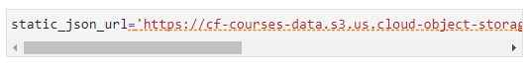
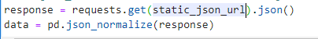
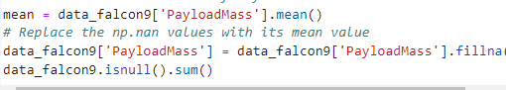
Data Collection – SpaceX API
Present your data collection with SpaceX REST calls using key phrases and flowcharts
Add the GitHub URL of the completed SpaceX API calls notebook (must include completed code cell and outcome cell), as an external reference and peer-review purpose

Slide 9
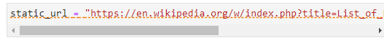
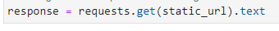
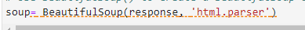
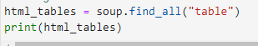
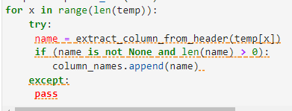
Data Collection - Scraping
Present your web scraping process using key phrases and flowcharts
Add the GitHub URL of the completed web scraping notebook, as an external reference and peer-review purpose

Slide 10
Data Wrangling
We performed exploratory data analysis and determined the training labels.
We calculated the number of launches at each site, and the number and occurrence of each orbits
We created landing outcome label from outcome column and exported the results to csv.
Add the GitHub URL of your completed data wrangling related notebooks, as an external reference and peer-review purpose

Slide 11
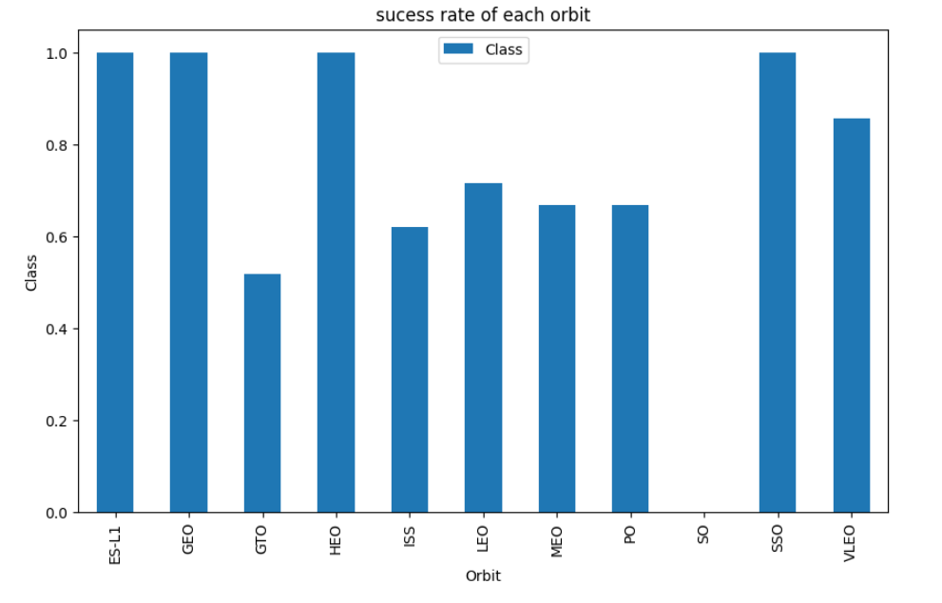
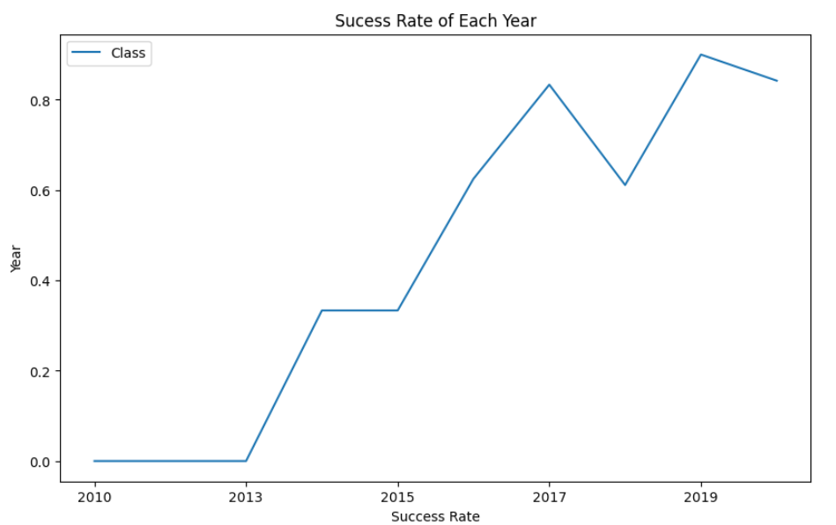
EDA with Data Visualization
We explored the data by visualizing the relationship between flight number and launch Site, payload and launch site, success rate of each orbit type, flight number and orbit type, the launch success yearly trend.
Add the GitHub URL of your completed EDA with data visualization notebook, as an external reference and peer-review purpose

Slide 12
EDA with SQL
Using bullet point format, summarize the SQL queries you performed
%sql SELECT DISTINCT(LAUNCH_SITE) from SPACEXTBL
%sql SELECT LAUNCH_SITE from SPACEXTBL where (LAUNCH_SITE) LIKE 'CCA%' LIMIT 5;
%sql select sum(PAYLOAD_MASS__KG_) as payloadmass from SPACEXTBL;
%sql select avg(PAYLOAD_MASS__KG_) as payloadmass from SPACEXTBL;
%sql select min(DATE) from SPACEXTBL;
%sql select BOOSTER_VERSION from SPACEXTBL where LANDING_OUTCOME='Success (drone ship)' and PAYLOAD_MASS__KG_ BETWEEN 4000 and 6000;
%sql SELECT LANDING_OUTCOME FROM SPACEXTBL WHERE DATE BETWEEN '2010-06-04' AND '2017-03-20' ORDER BY DATE DESC;
Add the GitHub URL of your completed EDA with SQL notebook, as an external reference and peer-review purpose

Slide 13
Build an Interactive Map with Folium
Summarize what map objects such as markers, circles, lines, etc. you created and added to a folium map
We marked all launch sites, and added map objects such as markers, circles, lines to mark the success or failure of launches for each site on the folium map.
We assigned the feature launch outcomes (failure or success) to class 0 and 1.i.e., 0 for failure, and 1 for success.
Using the color-labeled marker clusters, we identified which launch sites have relatively high success rate.
We calculated the distances between a launch site to its proximities. We answered some question for instance: - Are launch sites near railways, highways and coastlines. - Do launch sites keep certain distance away from cities.
Add the GitHub URL of your completed interactive map with Folium map, as an external reference and peer-review purpose

Slide 14
Build a Dashboard with Plotly Dash
Summarize what plots/graphs and interactions you have added to a dashboard
We built an interactive dashboard with Plotly dash
We plotted pie charts showing the total launches by a certain sites
We plotted scatter graph showing the relationship with Outcome and Payload Mass (Kg) for the different booster version.
Add the GitHub URL of your completed Plotly Dash lab, as an external reference and peer-review purpose

Slide 15
Predictive Analysis (Classification)
Summarize how you built, evaluated, improved, and found the best performing classification model
We loaded the data using numpy and pandas, transformed the data, split our data into training and testing.
We built different machine learning models and tune different hyperparameters using GridSearchCV.
We used accuracy as the metric for our model, improved the model using feature engineering and algorithm tuning.
We found the best performing classification model.
Add the GitHub URL of your completed predictive analysis lab, as an external reference and peer-review purpose

Slide 16
Results
Exploratory data analysis results
Interactive analytics demo in screenshots
Predictive analysis results

Slide 17

Section 2

Slide 18
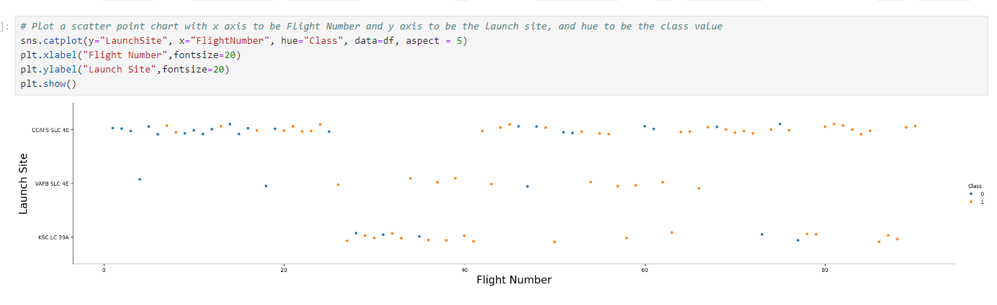
Flight Number vs. Launch Site
Show a scatter plot of Flight Number vs. Launch Site
Show the screenshot of the scatter plot with explanations

Slide 19
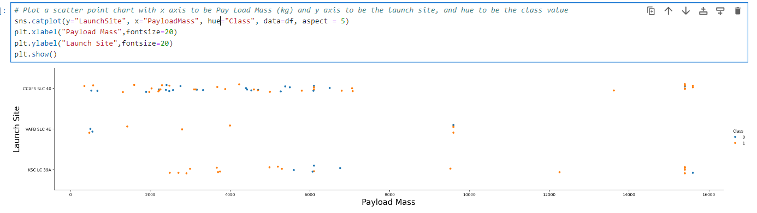
Payload vs. Launch Site
Show a scatter plot of Payload vs. Launch Site
Show the screenshot of the scatter plot with explanations

Slide 20
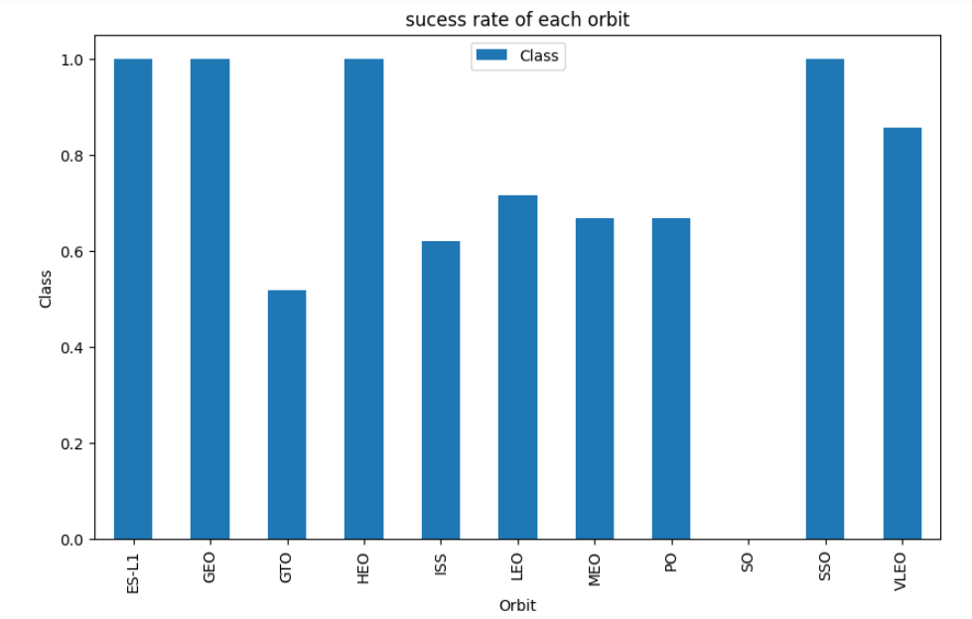
Success Rate vs. Orbit Type
Show a bar chart for the success rate of each orbit type
Show the screenshot of the scatter plot with explanations

Slide 21
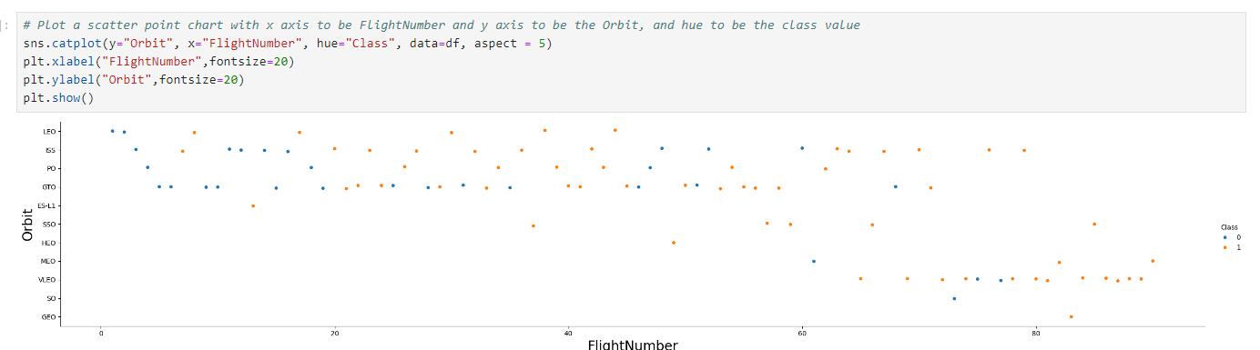
Flight Number vs. Orbit Type
Show a scatter point of Flight number vs. Orbit type
Show the screenshot of the scatter plot with explanations

Slide 22
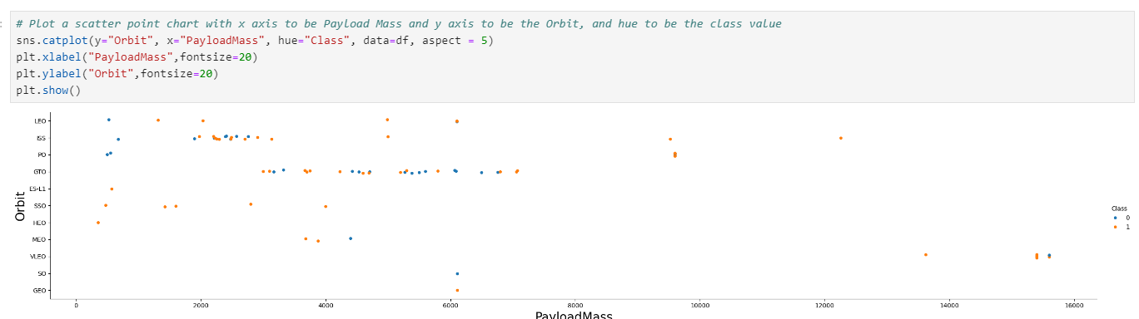
Payload vs. Orbit Type
Show a scatter point of payload vs. orbit type
Show the screenshot of the scatter plot with explanations

Slide 23
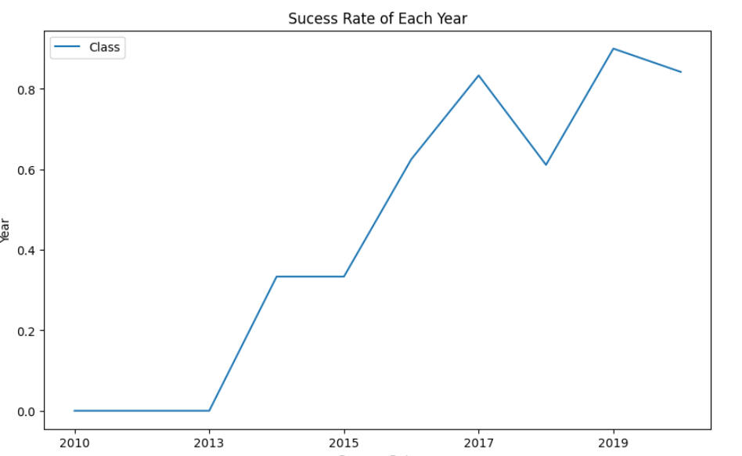
Launch Success Yearly Trend
Show a line chart of yearly average success rate
Show the screenshot of the scatter plot with explanations

Slide 24
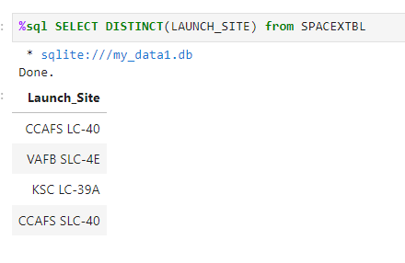
All Launch Site Names
Find the names of the unique launch sites
Present your query result with a short explanation here

Slide 25
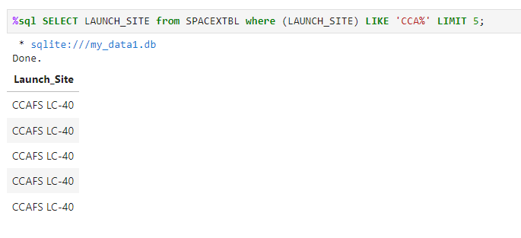
Launch Site Names Begin with 'CCA'
Find 5 records where launch sites begin with `CCA`
Present your query result with a short explanation here

Slide 26
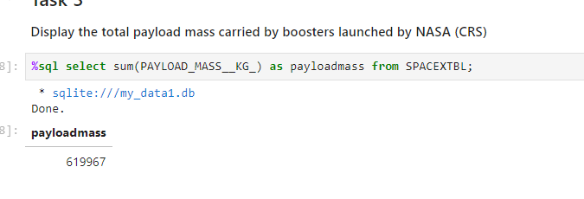
Total Payload Mass
Calculate the total payload carried by boosters from NASA
Present your query result with a short explanation here

Slide 27
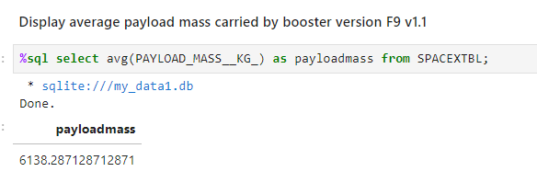
Average Payload Mass by F9 v1.1
Calculate the average payload mass carried by booster version F9 v1.1
Present your query result with a short explanation here

Slide 28
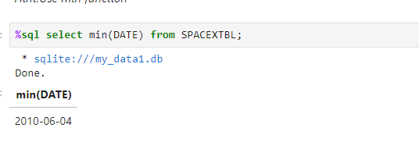
First Successful Ground Landing Date
Find the dates of the first successful landing outcome on ground pad
Present your query result with a short explanation here

Slide 29
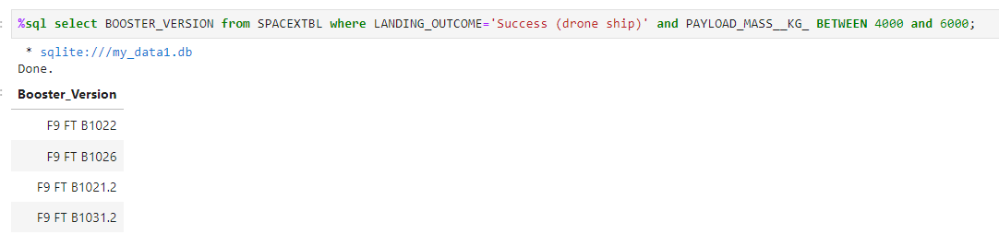
Successful Drone Ship Landing with Payload between 4000 and 6000
List the names of boosters which have successfully landed on drone ship and had payload mass greater than 4000 but less than 6000
Present your query result with a short explanation here

Slide 30
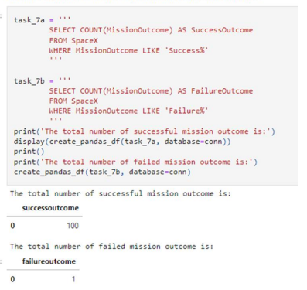
Total Number of Successful and Failure Mission Outcomes
Calculate the total number of successful and failure mission outcomes
Present your query result with a short explanation here

Slide 31
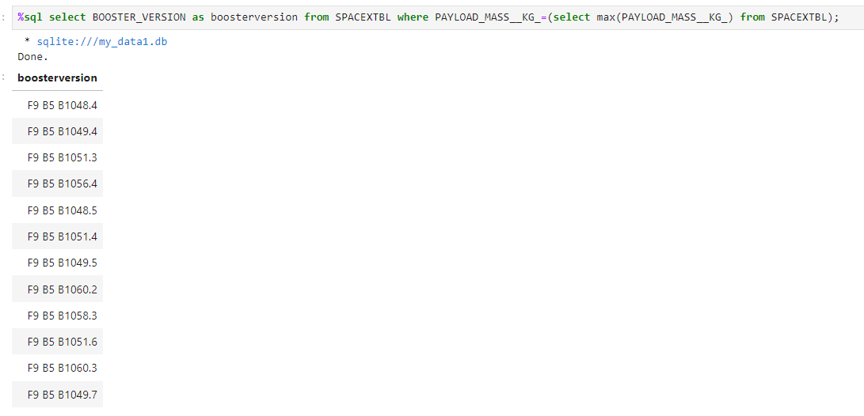
Boosters Carried Maximum Payload
List the names of the booster which have carried the maximum payload mass
Present your query result with a short explanation here

Slide 32
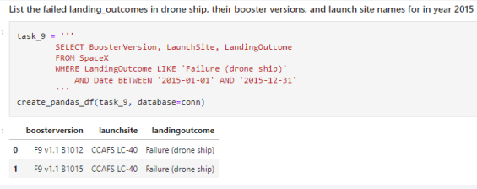
2015 Launch Records
List the failed landing_outcomes in drone ship, their booster versions, and launch site names for in year 2015
Present your query result with a short explanation here

Slide 33
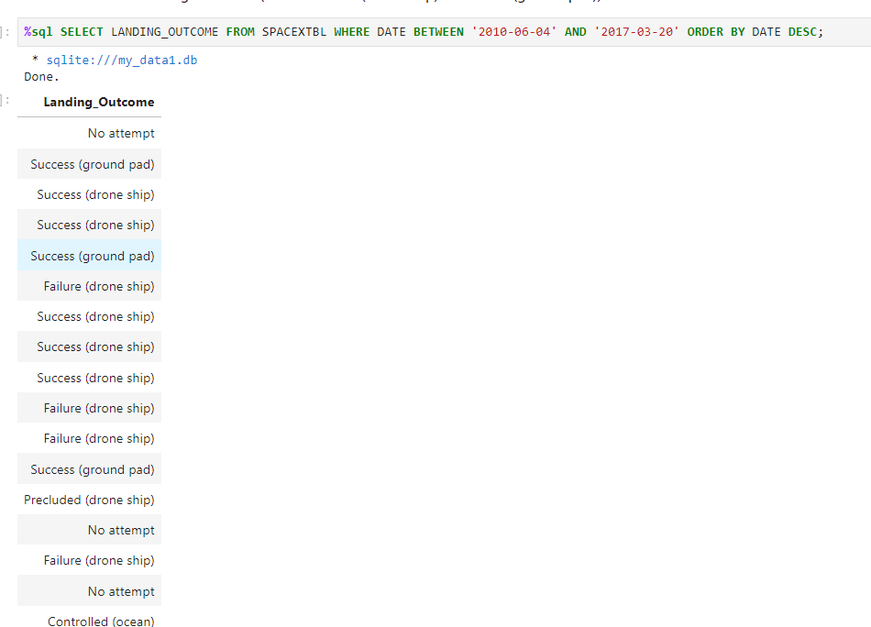
Rank Landing Outcomes Between 2010-06-04 and 2017-03-20
Rank the count of landing outcomes (such as Failure (drone ship) or Success (ground pad)) between the date 2010-06-04 and 2017-03-20, in descending order
Present your query result with a short explanation here

Slide 34

Section 3

Slide 35
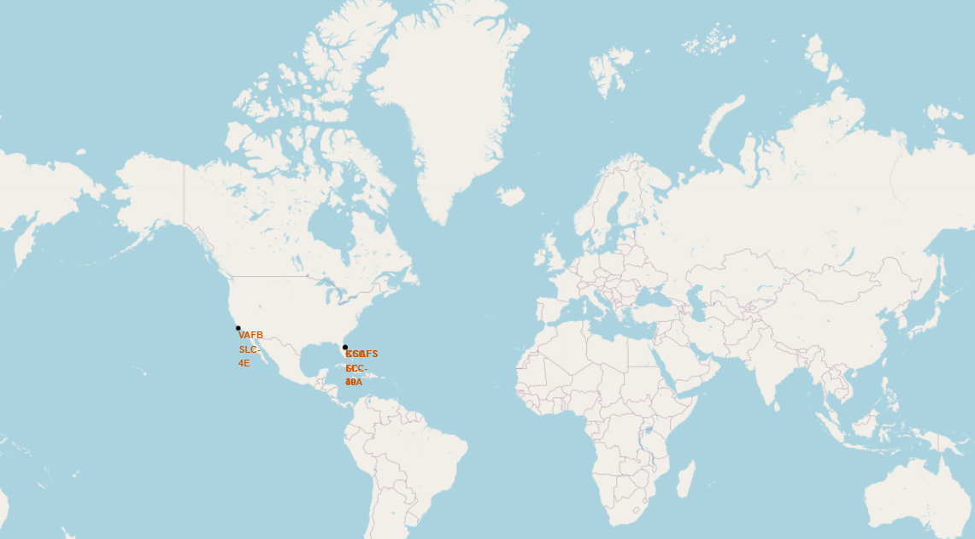
<Folium Map Screenshot 1>
Replace <Folium map screenshot 1> title with an appropriate title
Explore the generated folium map and make a proper screenshot to include all launch sites’ location markers on a global map
Explain the important elements and findings on the screenshot

Slide 36
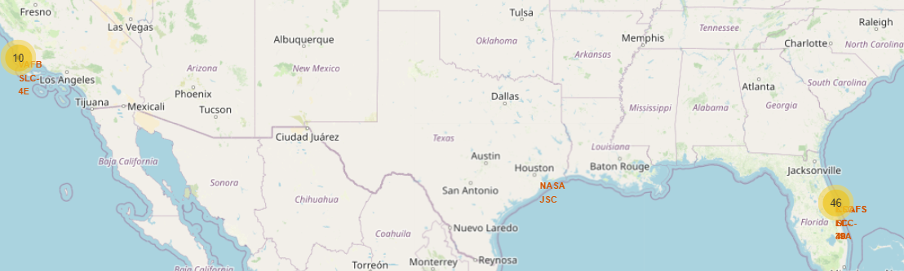
<Folium Map Screenshot 2>
Replace <Folium map screenshot 2> title with an appropriate title
Explore the folium map and make a proper screenshot to show the color-labeled launch outcomes on the map
Explain the important elements and findings on the screenshot

Slide 37
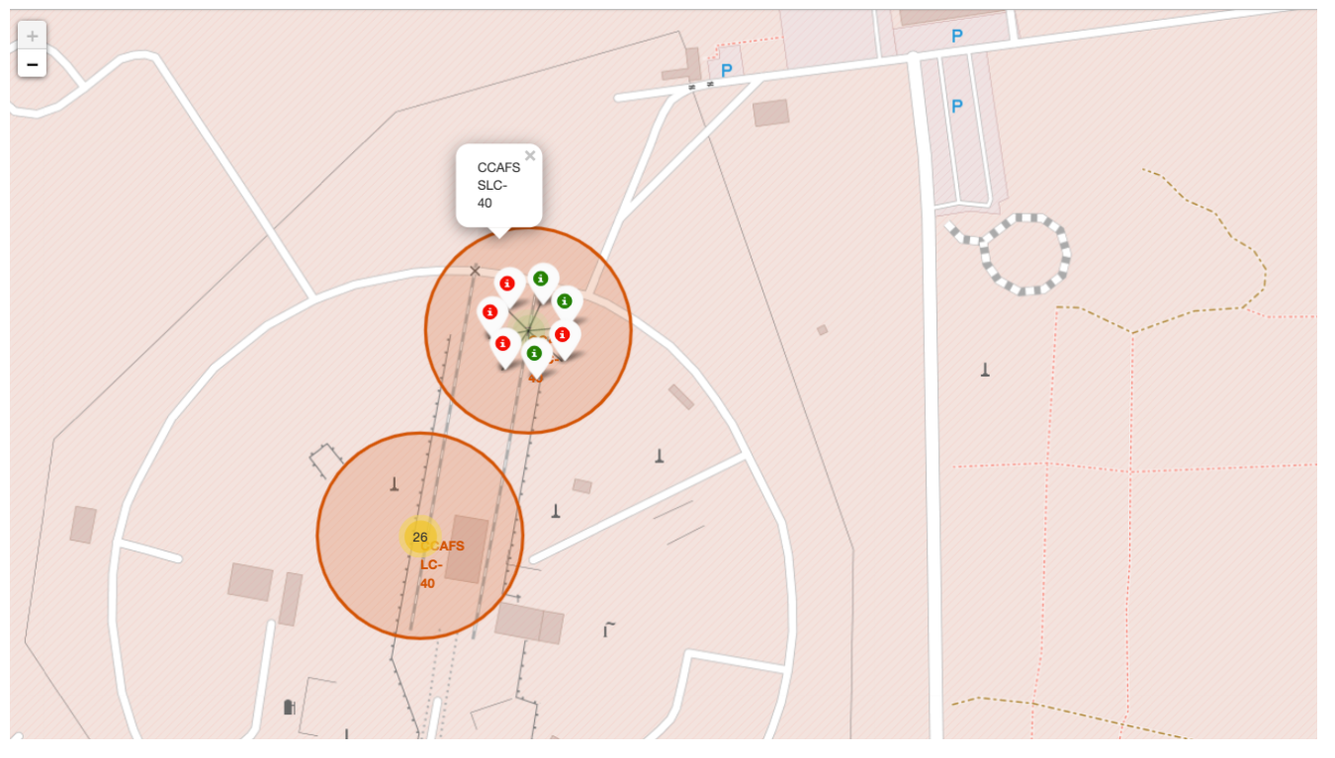
<Folium Map Screenshot 3>
Replace <Folium map screenshot 3> title with an appropriate title
Explore the generated folium map and show the screenshot of a selected launch site to its proximities such as railway, highway, coastline, with distance calculated and displayed
Explain the important elements and findings on the screenshot

Slide 38

Section 4

Slide 39
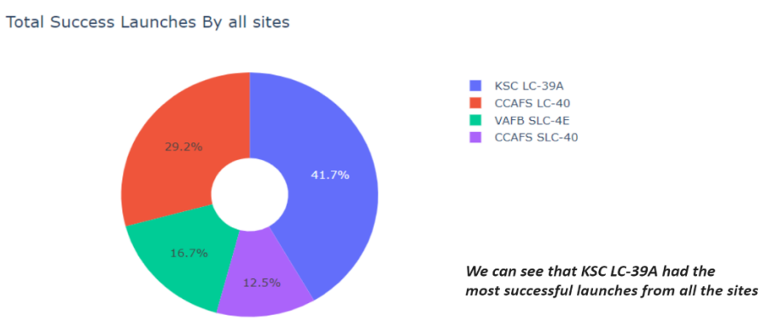
<Dashboard Screenshot 1>
Replace <Dashboard screenshot 1> title with an appropriate title
Show the screenshot of launch success count for all sites, in a piechart
Explain the important elements and findings on the screenshot

Slide 40
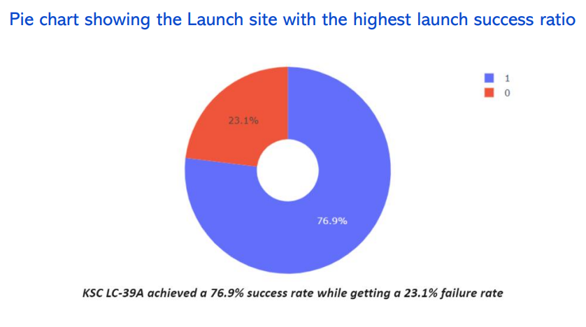
<Dashboard Screenshot 2>
Replace <Dashboard screenshot 2> title with an appropriate title
Show the screenshot of the piechart for the launch site with highest launch success ratio
Explain the important elements and findings on the screenshot

Slide 41
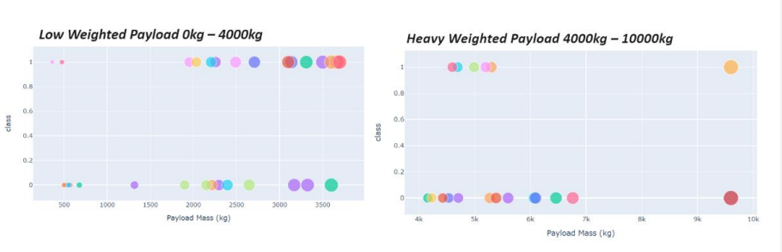
<Dashboard Screenshot 3>
Replace <Dashboard screenshot 3> title with an appropriate title
Show screenshots of Payload vs. Launch Outcome scatter plot for all sites, with different payload selected in the range slider
Explain the important elements and findings on the screenshot, such as which payload range or booster version have the largest success rate, etc.

Slide 42

Section 5

Slide 43
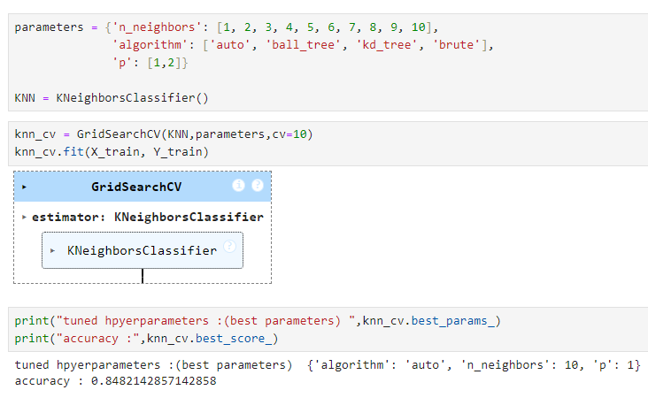
Classification Accuracy
Visualize the built model accuracy for all built classification models, in a bar chart
Find which model has the highest classification accuracy

Slide 44
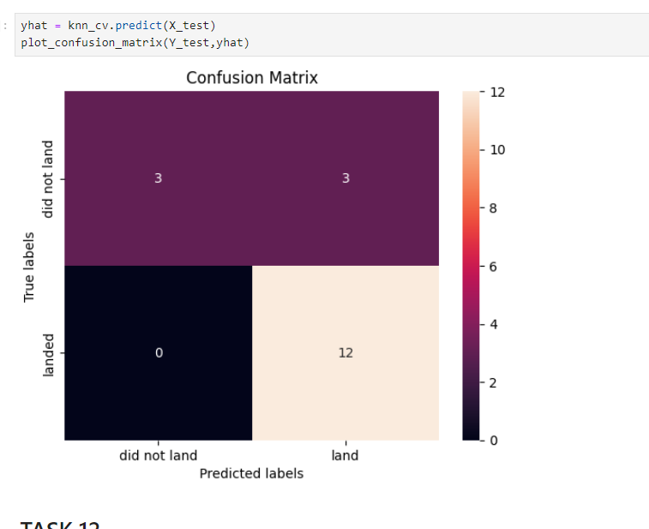
Confusion Matrix
Show the confusion matrix of the best performing model with an explanation

Slide 45
Conclusions
Point 1
The larger the flight amount at the launch site, the greater the success rate
Point 2
Launch success rate started to increase between 2013 and 2020
Point 3
Orbits ES-L1, GEO, HEO, SSO, VLEO had the most success rate.
Point 4
KSC LC-39A had the most successful launches of any sites.
The Decision tree classifier is the best machine learning algorithm for this task

Slide 46
Appendix
Include any relevant assets like Python code snippets, SQL queries, charts, Notebook outputs, or data sets that you may have created during this project

Slide 47


